Slide 1
Adversarial Attacks
Bardia Esmaeili

Slide 2
Introduction
Neural Networks have achieved great performance in many computer vision tasks such as Pattern Recognition and Image Classification
They are vulnerable to a class of attacks called Adversarial Attacks, hence making them unreliable for sensitive tasks such as Face Recognition, Malware Detection, Fraud Detection, Vulnerability Detection, and Self Driving Cars.

Slide 3
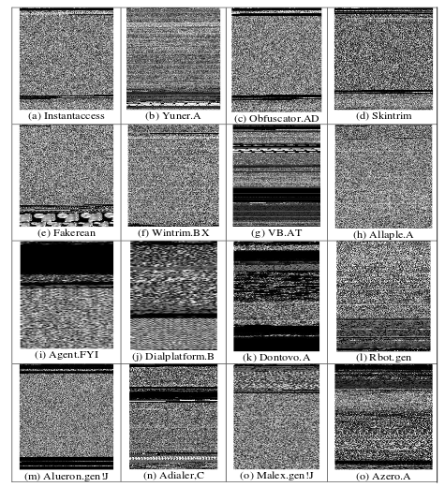
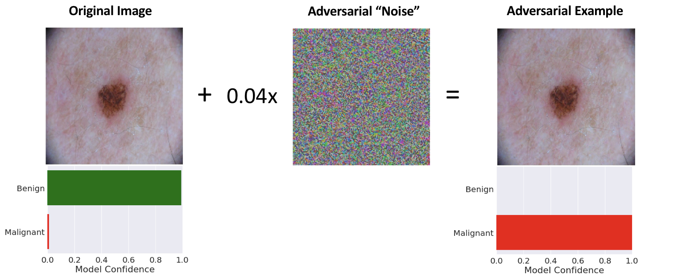

Application of Machine Learning
Stop Sign
Autonomous Cars
Malware Detection
Cancer Recognition

Slide 4
Basics of Adversarial Attacks
The goal is to add a targeted and imperceptible (very small) noise (perturbation) to the input in such a way that the below condition is satisfied:

Slide 5
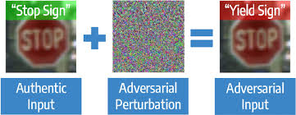
Danger of Adversarial Examples
Causing Misclassification for
Cancer Recognition
Causing Misclassification for
Sign Recognition

Slide 6
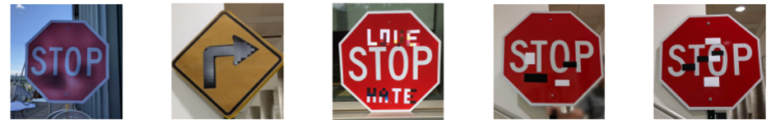
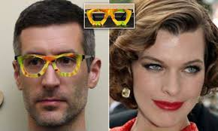
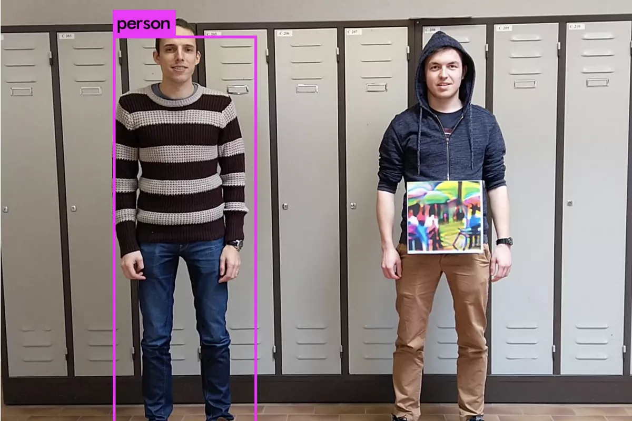
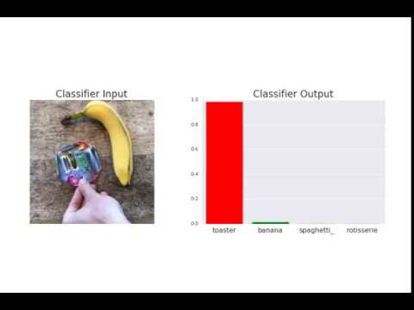
Physical Adversarial Examples

Slide 7
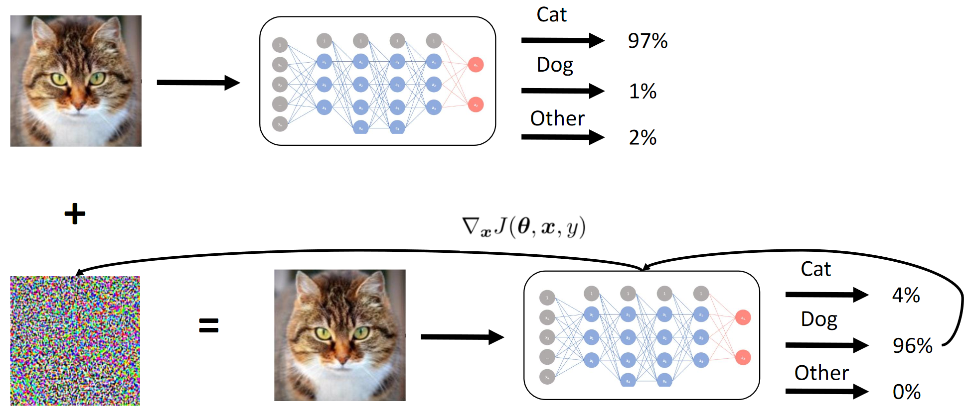
White-Box Attacks (Gradient-Based)

Slide 8
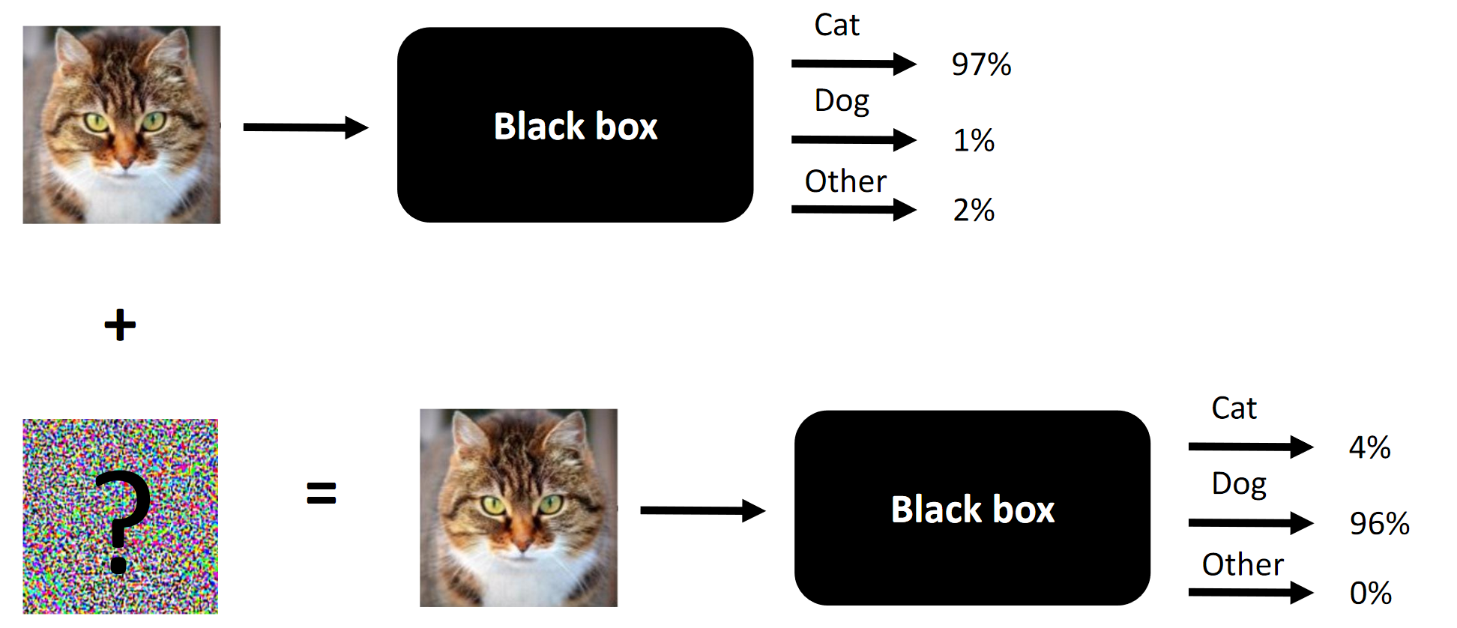
Black-Box Attacks (Query-Based)

Slide 9
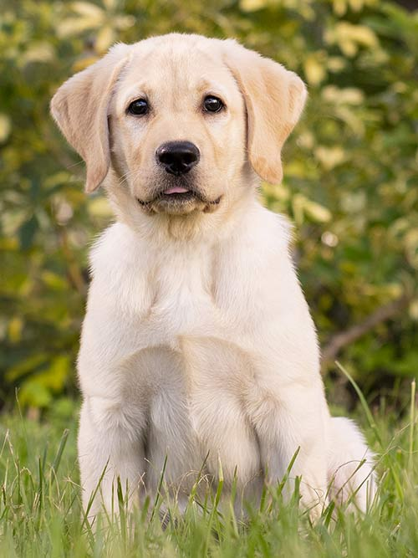
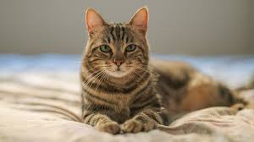
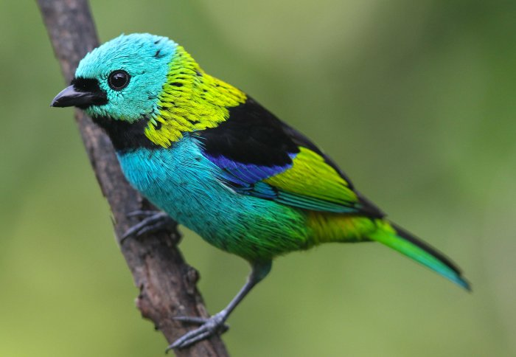
Targeted and Untargeted Attacks
F(x + ε) = y* where y* = y_{target}
Targeted Attack
F(x + ε) = y* where y* ≠ y_{true}
OR
Untargeted Attack

Slide 10
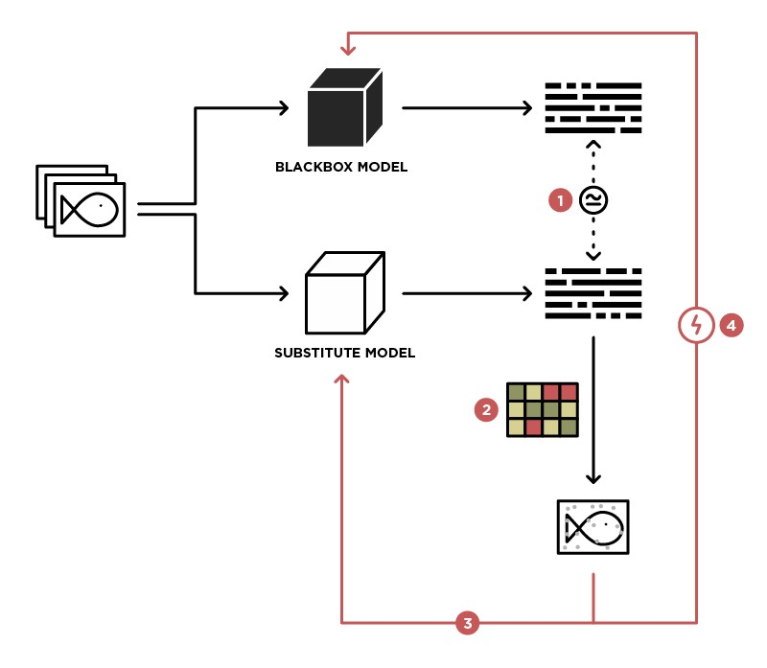
Transfer-Based Attacks
Generated adversarial examples are transferable.
Using a substitute model for generating samples

Slide 11
Categories of Adversarial Attacks
White-Box
Targeted
L-BFGS-B
JSMA
Untargeted
Fast Gradient Sign Method
DeepFool
Black-Box
Score-Based (Detailed Model Prediction)
Untargeted
Local Search
Targeted
Zoo
Decision-Based (Maximum Class Label)
Boundary Attack

Slide 12
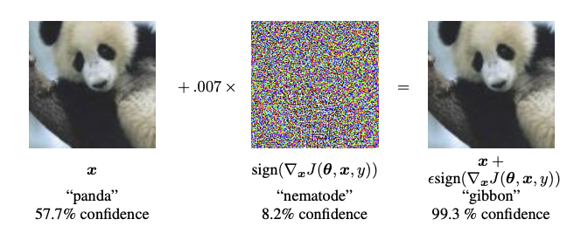
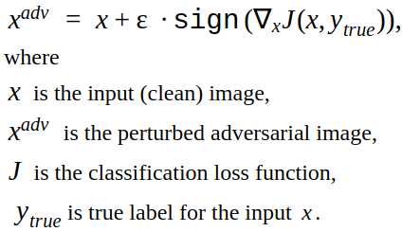
Fast Gradient Sign Method (FGSM)
One of the most well known White-box attacks
Works by adding a fraction of the sign of the gradient of the loss function with respect to input data
Goodfellow, Ian J., Jonathon Shlens, and Christian Szegedy. "Explaining and harnessing adversarial examples."

Slide 13
DeepFool
Proposing a measure for calculating the robustness of classifiers against adversarial attacks.
Generating smaller, more efficient and less noticeable perturbations than sub-optimal ones from FGSM
Using adversarial examples for adversarial training for better robustness
Moosavi-Dezfooli, Seyed-Mohsen, Alhussein Fawzi, and Pascal Frossard. "Deepfool: a simple and accurate method to fool deep neural networks."

Slide 14
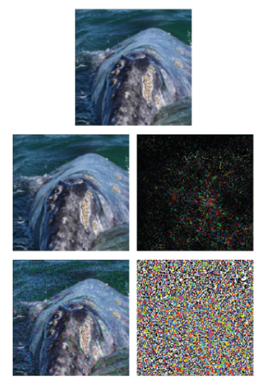
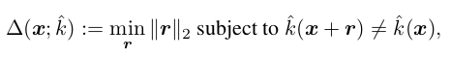
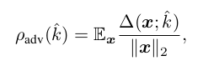
FGSM Noise vs DeepFool Noise
Objective
Robustness Measure
FGSM Noise vs DeepFool Noise

Slide 15
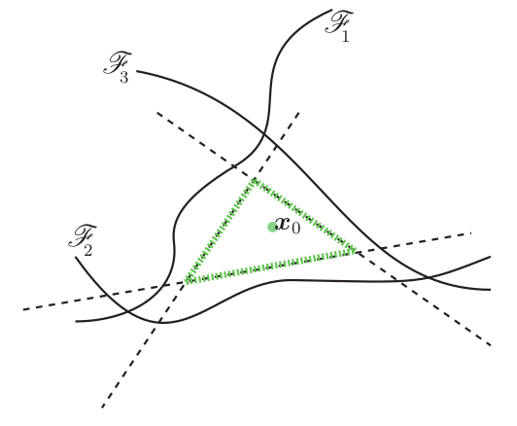
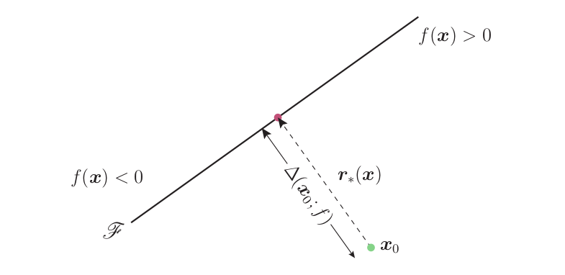
Functionality For Linear Binary Classifiers
Functionality For Multi-Class Classifiers

Slide 16
Decision Boundary Attack
Works only with The final score
No Knowledge needed from Training data or the Parameters of the Model hence more related to real-world situations
Easy to apply in comparison to transfer-based attacks
Challenging to defend against
Competitive Results
Approximately no need for hyperparameter tuning
Brendel, Wieland, Jonas Rauber, and Matthias Bethge. "Decision-based adversarial attacks: Reliable attacks against black-box machine learning models."

Slide 17
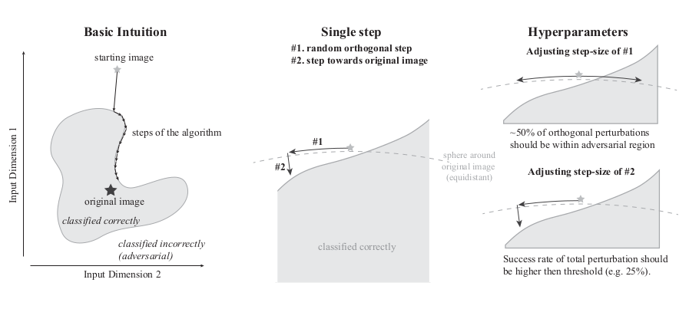
Functionality of Boundary Attack

Slide 18
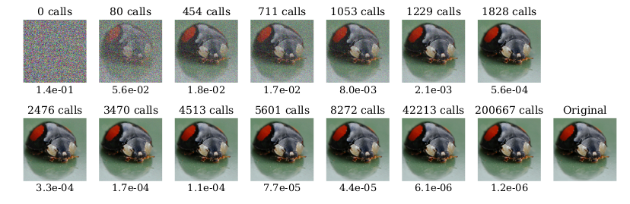
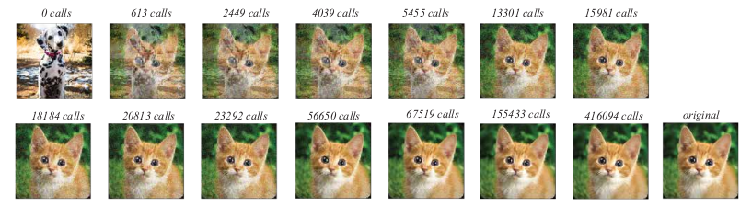
Untargeted
Targeted

Slide 19
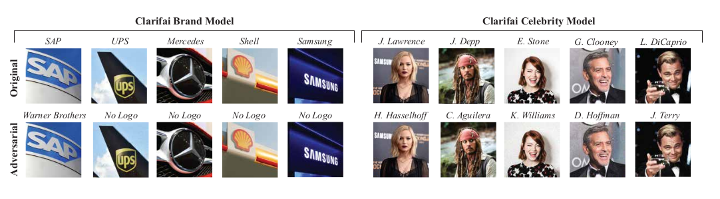
Attack on Clarfia API

Slide 20
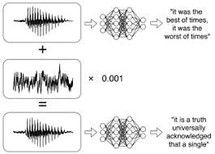
Audio Adversarial Examples
Targeted adversarial examples on speech recognition
Results on Images are applicable to audio.
Minimize d(x, x’) + CTC-Loss(x’, T)
Carlini, Nicholas, and David Wagner. "Audio adversarial examples: Targeted attacks on speech-to-text."

Slide 21
Defense
Gradient Masking using defensive distillation (Teacher and Student Networks)
Saturated Sigmoid Network (Causing Gradient Vanishing)
Adding Random Elements such as Dropout
Ensemble Adversarial Learning (Fine-tuning with adversarial examples)
Stateful Detection (Encoding similar Queries together)

Slide 22
Adversarial Training
Using the Fast Gradient Sign Method in the objective function (adversarial objective function) in order to add regularization

Slide 23
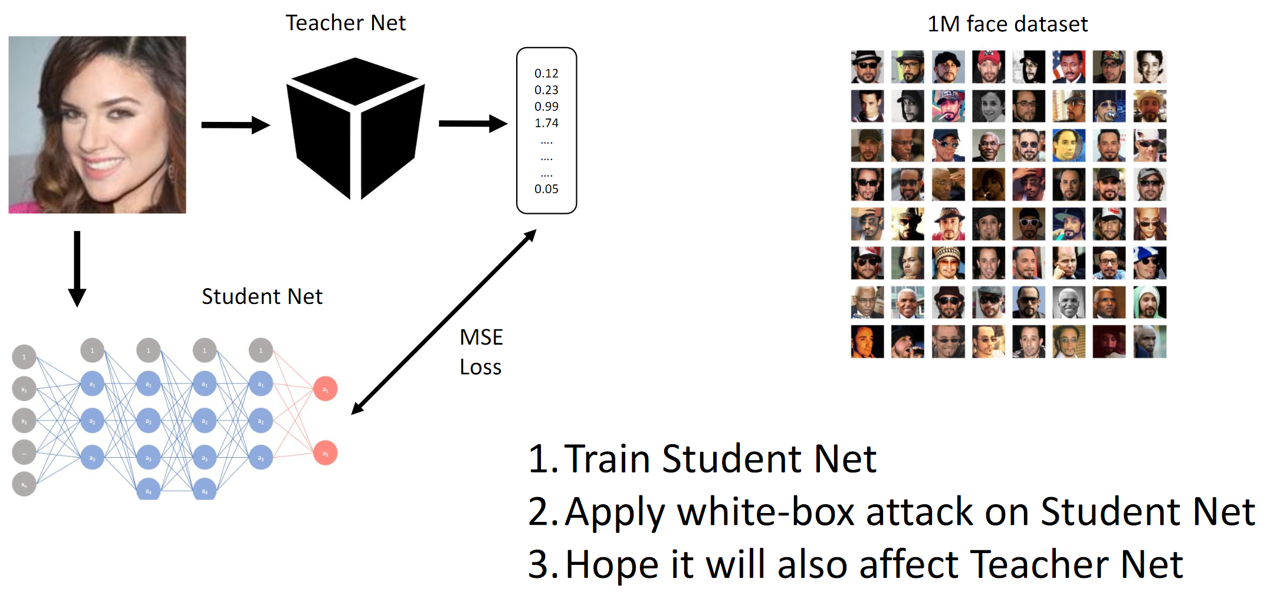
Defensive Distillation
Using labels of teacher for training the student
Teacher and student with the same architecture and Using temperature T

Slide 24
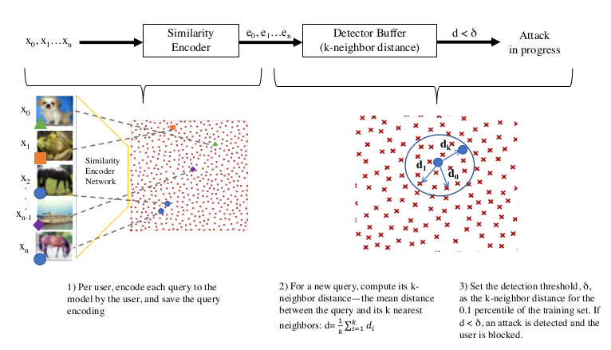
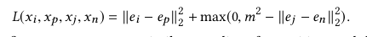
Stateful Detection
Effective for query-based attacks
Not effective against transfer-based attacks
Chen, Steven, Nicholas Carlini, and David Wagner. "Stateful detection of black-box adversarial attacks."

Slide 25


Well-known Frameworks
Foolbox

Slide 26
Thank You!

